Slide 1
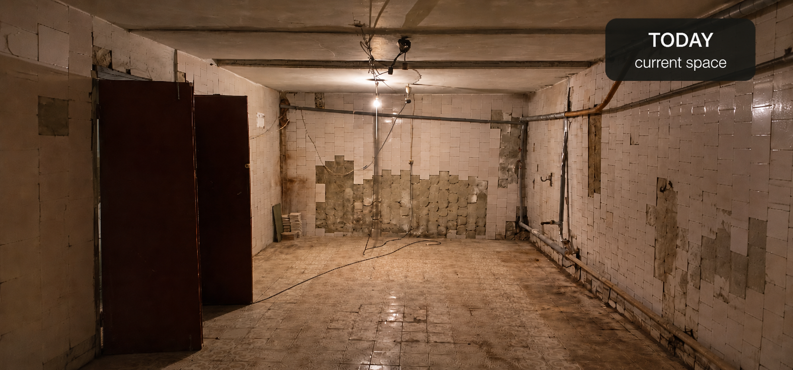

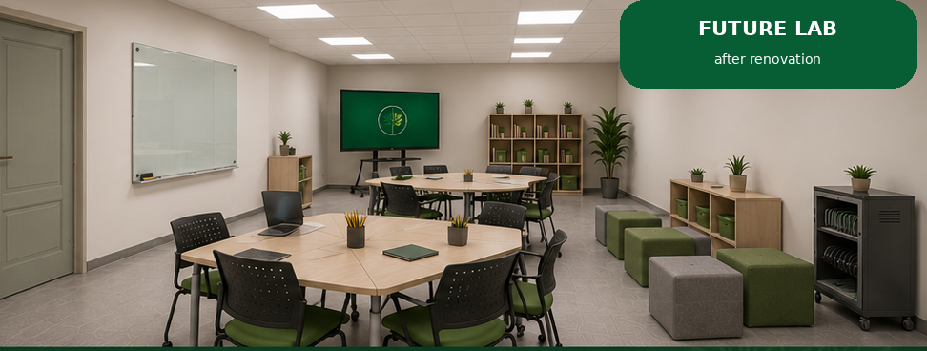
Vilkhuvatka
Leadership &
Learning Lab
Empowering children and youth with leadership, learning, and technology in a safe environment.
Project Proposal
Vilkhuvatka Rural Military Administration
Kharkiv Region, Ukraine
Leadership Development
Quality Education
Digital Skills
Inclusion & Support
Community Future

Slide 2
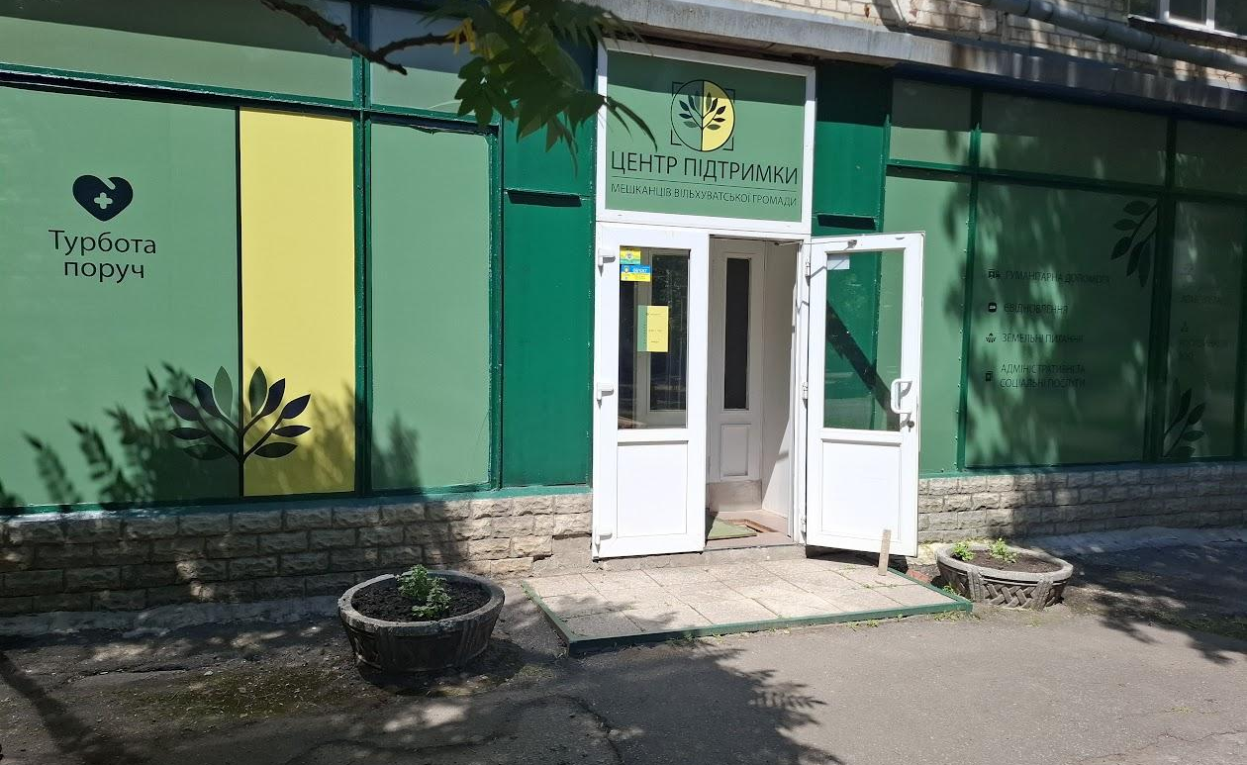





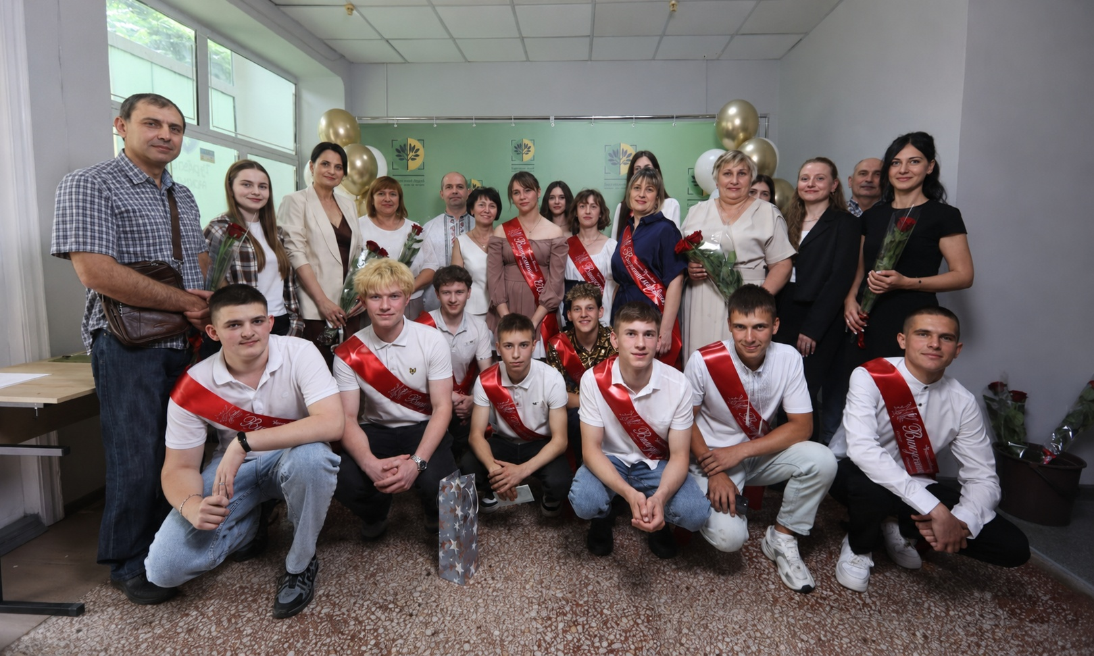
A Frontline Community Rebuilding Its Life in Kharkiv
Displaced by war, Vilkhuvatka Community continues to serve its residents through a support hub in Kharkiv.
Vilkhuvatka Community is a frontline community in Kharkiv Region. Many residents were forced to leave their homes and relocate to Kharkiv. The Hub helps the community stay connected, access essential services, and preserve community life.
2,437
30
Displaced residents
in Kharkiv
Settlements
0–20 km
76
From the frontline
Services through
the Hub
Kharkiv Support Hub
279.9 m²
Support center space
The Hub is already a place where community life continues — now it needs a dedicated space for youth leadership, learning, and development.

Slide 3
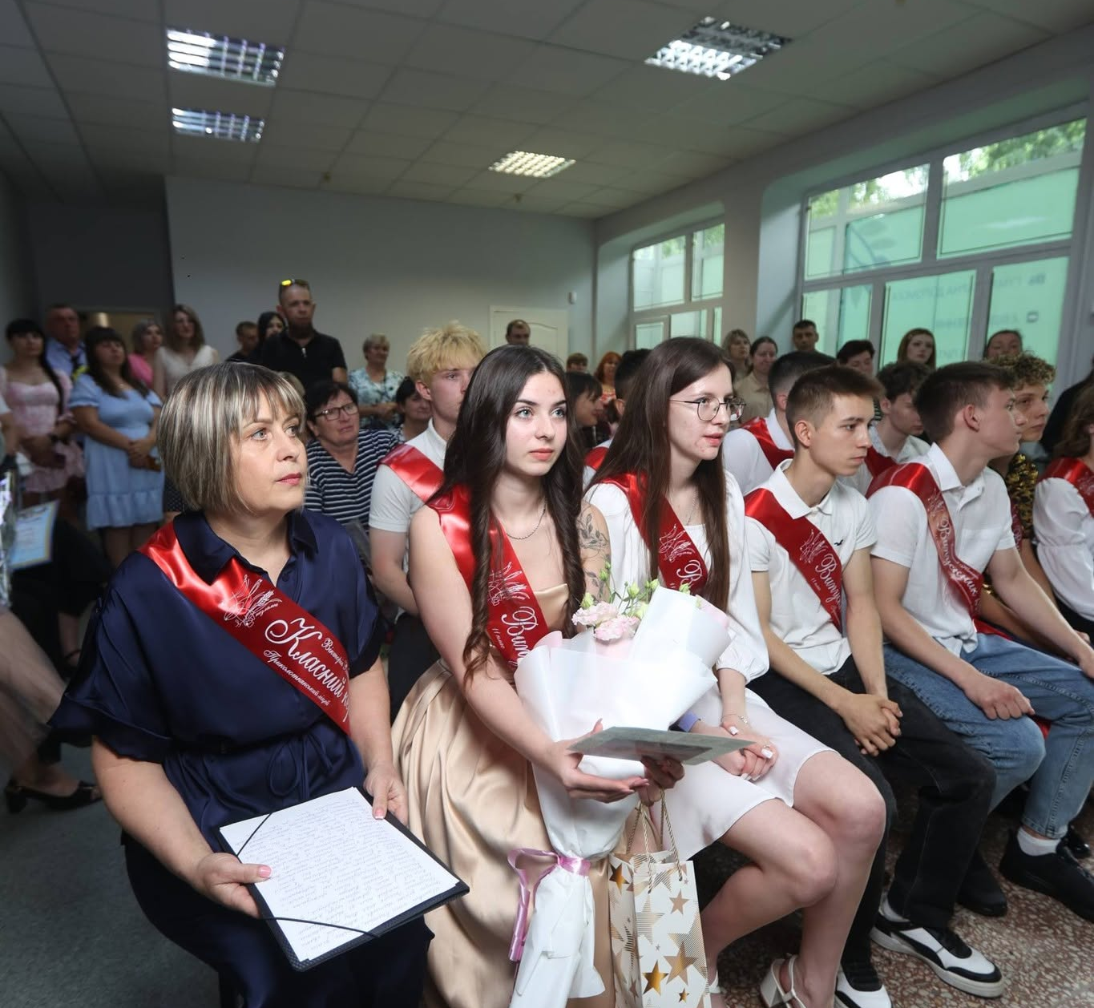




Why the Lab Is Needed
Displacement did not only move people away from home — it disrupted learning, peer connection, and youth development.
Learning loss
Safe youth space
Children need structured support to catch up and stay motivated.
Young people need a place to learn, gather, and feel protected.
Digital access
Leadership pathways
Technology skills are essential for future education and careers.
Youth need mentoring, teamwork, and project-based learning.
The next step is to transform an unused basement into a dedicated Leadership & Learning Lab for children and youth.
Education continues in displacement —
but young people need a dedicated space.
From a support hub to a youth development ecosystem

Slide 4
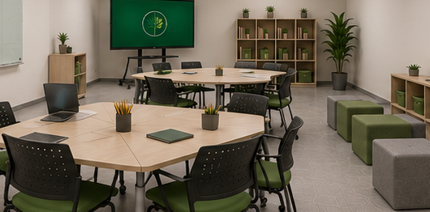
Our Vision: From Basement to Leadership
& Learning Lab
A renovated protected space designed for learning, collaboration, leadership, and community recovery.
THE SOLUTION
Transform an unused basement into a modern, flexible Lab where children and youth can learn, collaborate, develop leadership skills, and prepare to rebuild their community.
Future Leadership & Learning Lab
Learn
Collaborate
Lead
Catch-up learning and school readiness.
Team projects and peer learning.
Leadership, responsibility, and initiative.

Slide 5
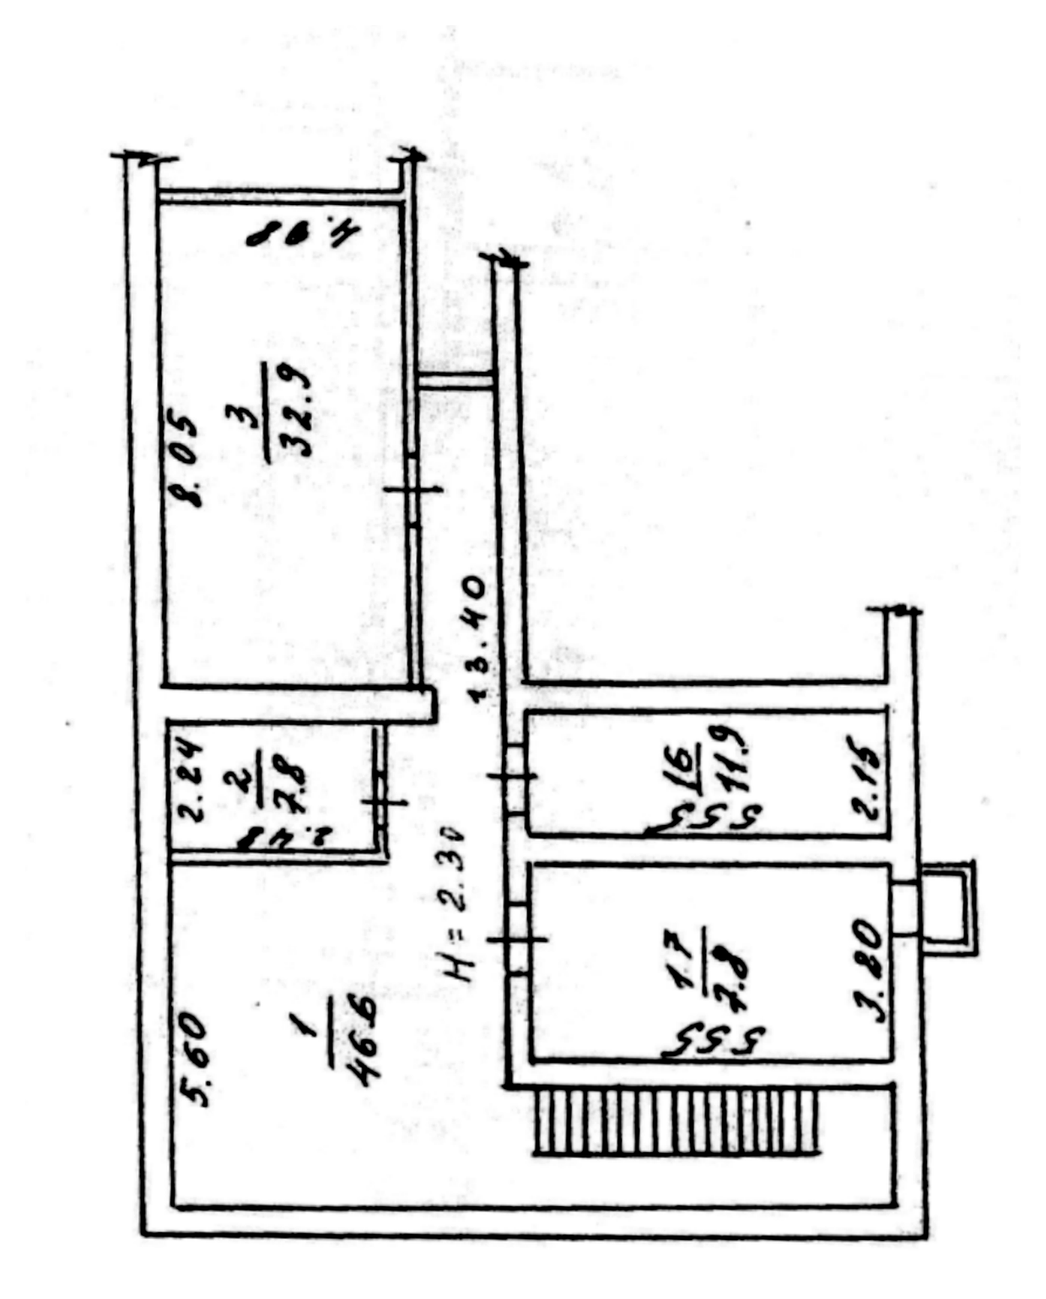
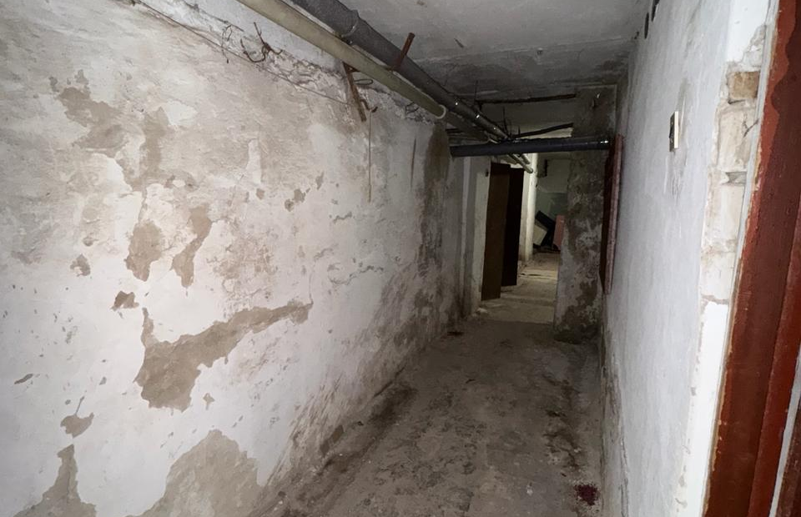
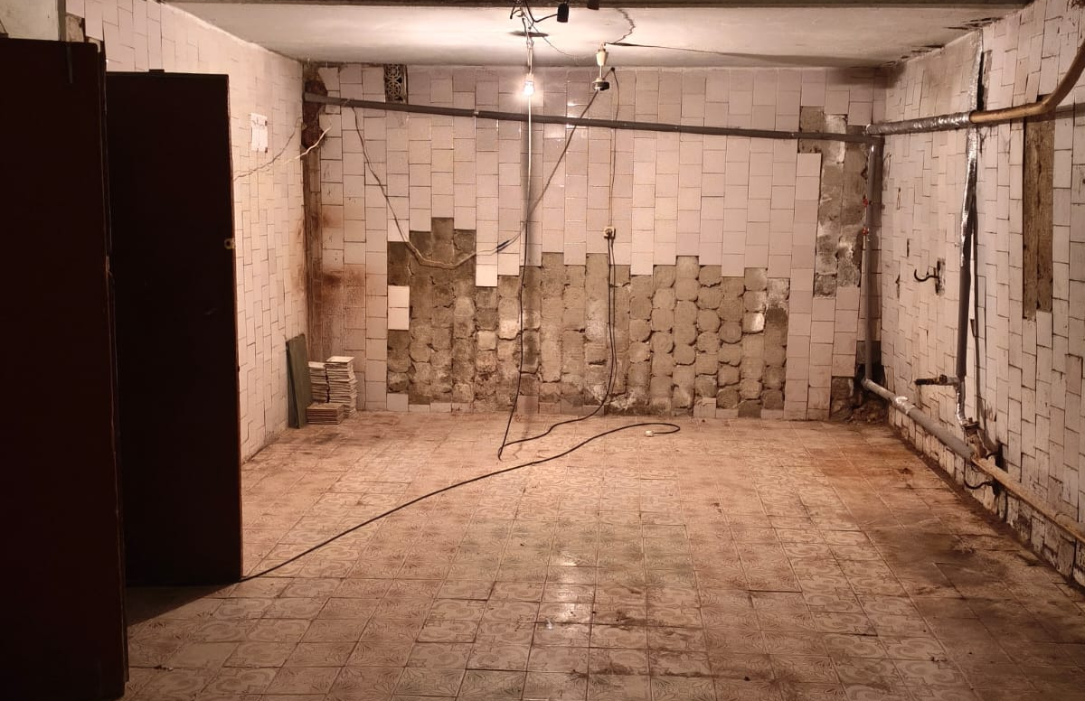
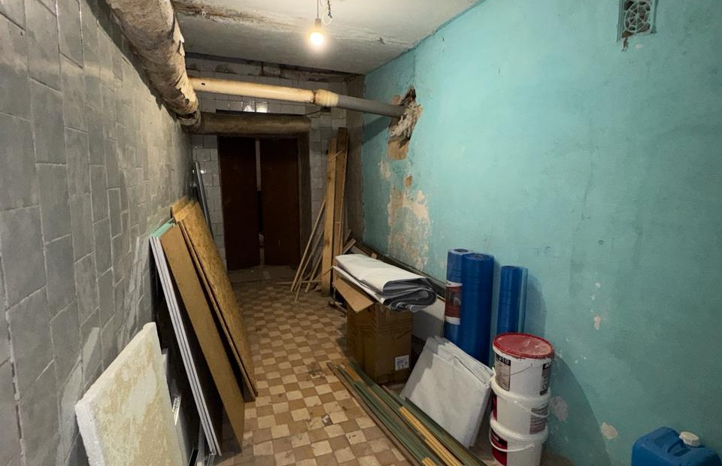
The Space We Will Transform
A 117 m² protected underground facility will become the physical home of the Leadership & Learning Lab.
Current condition
Basement plan: 117 m² total area
The space has a strong structural base, but it requires renovation, lighting, ventilation, flooring, and equipment.
Existing access area
Surfaces requiring renovation
Rooms for future zoning
117 m²
5 rooms
Total facility area
Plus corridor and entrance
≈2.30 m
32.9 m²
Separate rooms make it possible to combine learning, mentoring, inclusion, and technology activities.
Ceiling height
Priority learning room
The grant will turn an underused basement into a safe, functional, and inspiring learning environment.

Slide 6
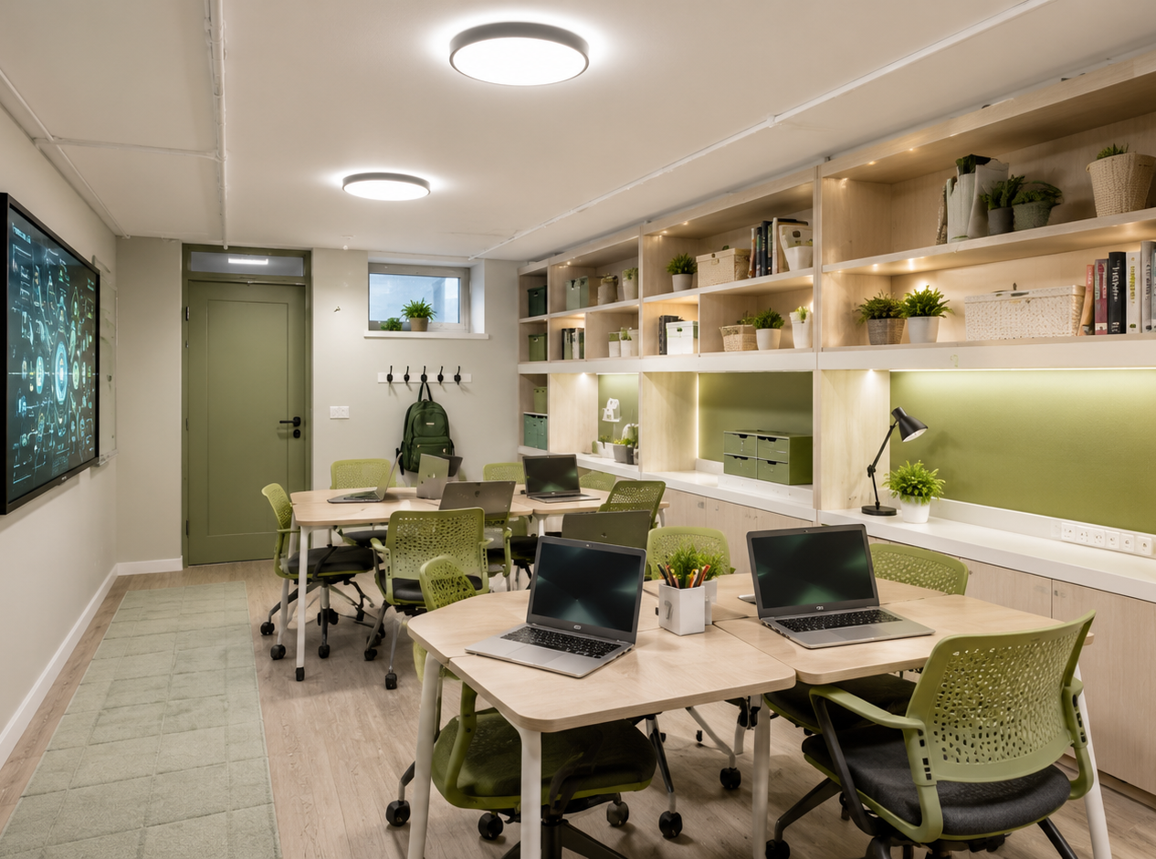
What the Lab Will Offer
Six connected program areas will turn the renovated space into a youth development engine.
Learning
Recovery
School
Readiness
Leadership
Workshops
Catch-up classes to address learning gaps.
Preparation for preschool children entering first grade.
Teamwork, communication, and civic responsibility.
Digital
Skills
Inclusion &
SEN Support
Project-Based
Learning
Basic IT, online learning, and safe technology use.
Activities for children with special educational needs.
Youth initiatives, presentations, and community projects.
Small Digital Skills & Teamwork Room
The Lab will connect education, leadership, and technology — matching the sponsor’s focus on people, management, and future skills.
Teamwork
Digital Skills
Project Work
A flexible small-room format for digital literacy, collaborative work, online learning, and project preparation.
Delivered by the community’s teachers, social workers, and specialists

Slide 7
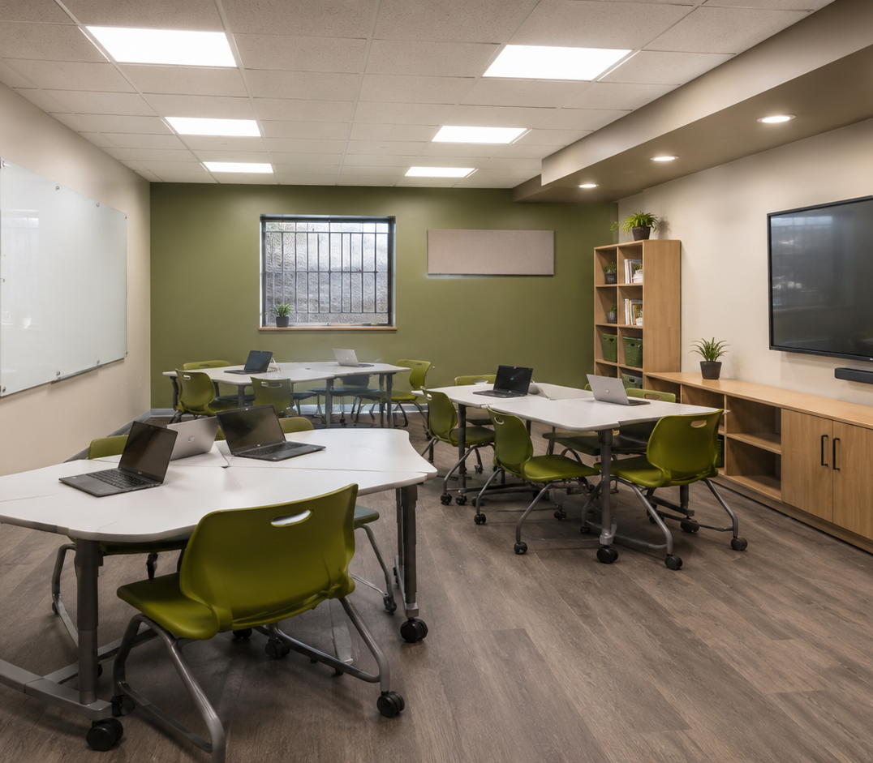
Flexible Learning Formats
One renovated room can support different activities — from lessons to youth project presentations.
Four modes of use
Each format supports a different part of the youth development pathway.
Classroom mode
Learning recovery, school readiness, and structured lessons.
Teamwork mode
Small groups, brainstorming, presentations, and collaboration.
Digital mode
Online learning, basic IT skills, safe technology use, and presentations.
Leadership mode
Workshops, debates, mentoring, civic responsibility, and youth initiatives.
One room can adapt to class, workshop, project, and mentor formats.
Mobile design means higher utilization, more activities, and better long-term sustainability.

Slide 8
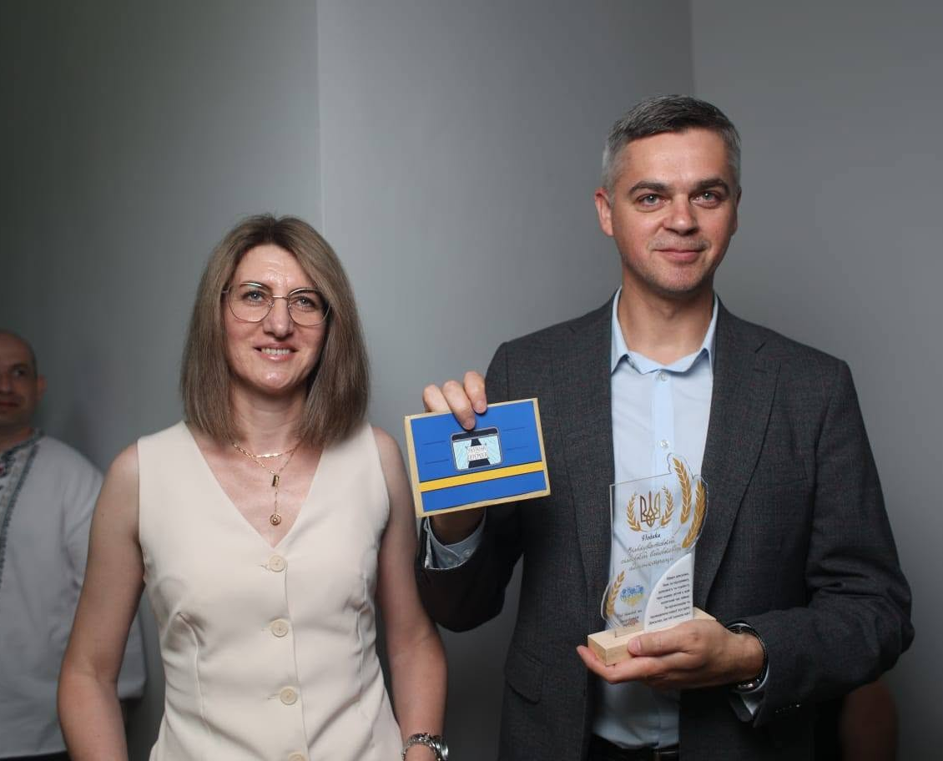

Community Capacity to Deliver
The grant will invest in space and equipment; the community will provide people, programs, and daily management.
Educators & mentors
Social services
Learning recovery, school readiness, workshops, and project guidance.
Family support, outreach, and coordination for vulnerable groups.
Inclusion & SEN support
Administration & partners
Activities adapted for children with special educational needs.
Daily coordination, accountability, reporting, and sustainability.
Existing Hub Team & Community Network
Existing Hub + Trained specialists + Renovated Lab
Teachers
Social workers
Specialists
The Lab will be operated by the community’s existing professional capacity, connected to the active Kharkiv Support Hub.
This is not a one-time activity — it is a long-term youth development platform managed by the community.
People are already in place. The missing piece is a modern, safe, equipped space.

Slide 9
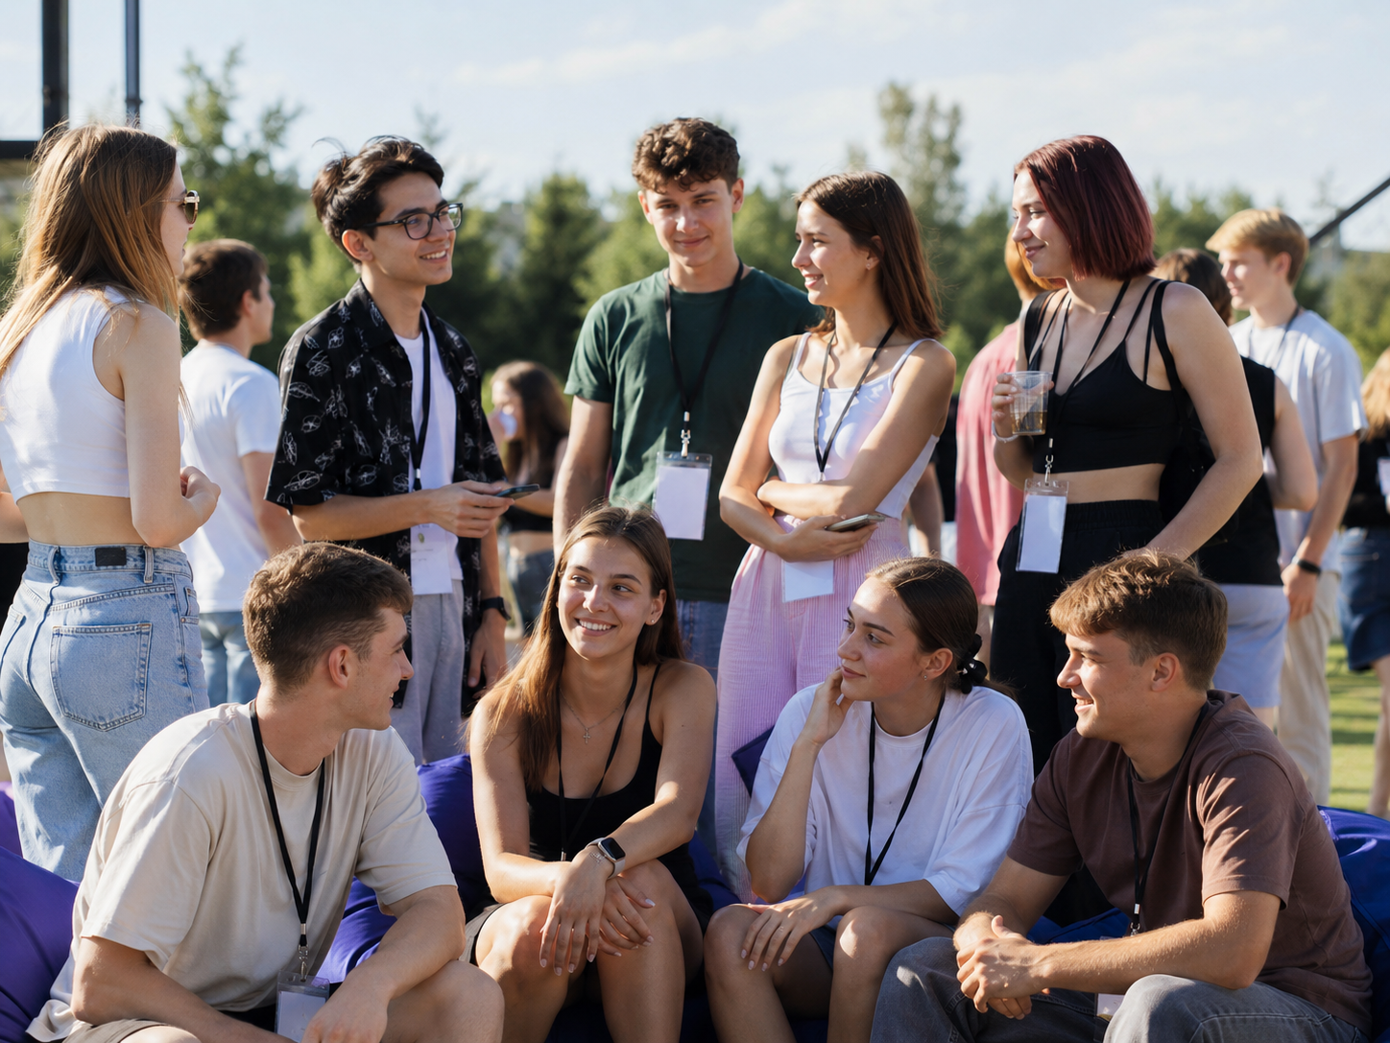
Expected Impact
The Lab will turn a renovated safe space into measurable progress for children, youth, and families.
What will change
Four outcome areas will guide implementation and reporting.
Learning recovery
Digital confidence
Catch-up classes for children affected by disruptions.
Basic technology skills and safe online learning.
Inclusive support
Youth leadership
Children with SEN receive adaptive activities and individual attention.
Teamwork, project development, presentations, and responsibility.
Community connection
From Participation to Leadership
Families stay connected to an active Kharkiv Support Hub while children and youth build their path to the future.
The goal is not only to provide activities, but to help young people regain confidence, skills, and a role in rebuilding their community.
Impact will be tracked through attendance, session outputs, completed youth projects, and parent feedback.
A renovated room becomes a platform for learning, confidence, and community recovery.

Slide 10
Funding Priorities
The grant will fund the one-time capital transformation of a 117 m² protected facility into a safe, functional, and fully equipped learning environment.
What funding will cover
Investment Request
The investment will prioritize capital works that make the basement safe and usable — then equip it for education, teamwork, and leadership activities.
US$140,400
Capital renovation
Basement restroom
≈ US$1,200 per m² • 117 m² protected facility
Walls, ceiling, electrical wiring, waterproofing, and finishing.
Sanitary unit, plumbing, drainage, and safe basic hygiene.
Capital transformation package: basement restroom, backup exit, ventilation, renovation works, flooring, lighting, furniture, technology, and learning equipment.
Backup exit
Ventilation system
Secondary exit and evacuation access for protected use.
Air exchange, humidity control, and healthier long-term use.
Community contribution
The community provides existing staff, program delivery, local coordination, and daily operation of the Lab.
Flooring & lighting
Furniture & equipment
Durable flooring and energy-efficient lighting.
Modular furniture, digital equipment, and learning materials.
Grant + local effort = long-term impact
A one-time investment creates protected infrastructure and a flexible youth development space for years to come.

Slide 11


Sustainability & Long-Term Operation
The Lab will not be a one-time activity. It will become part of the existing Kharkiv Support Hub ecosystem.
Operating model after the grant
Four practical mechanisms keep the Lab active, accountable, and useful for displaced residents.
Community management
Program calendar
Sustainable by design
Daily coordination by the Hub team.
Regular education, leadership, and project sessions.
The grant creates the physical infrastructure; the community provides the people, programs, coordination, and daily operation.
Local delivery team
Monitoring & reporting
Teachers, social workers, youth specialists, and volunteers.
Attendance, outputs, feedback, and simple impact tracking.
Grant-funded launch → community-owned operation
Renovated space + Existing team + Partner network + Programs
The renovated Lab will remain a community asset after the grant period ends.

Slide 12
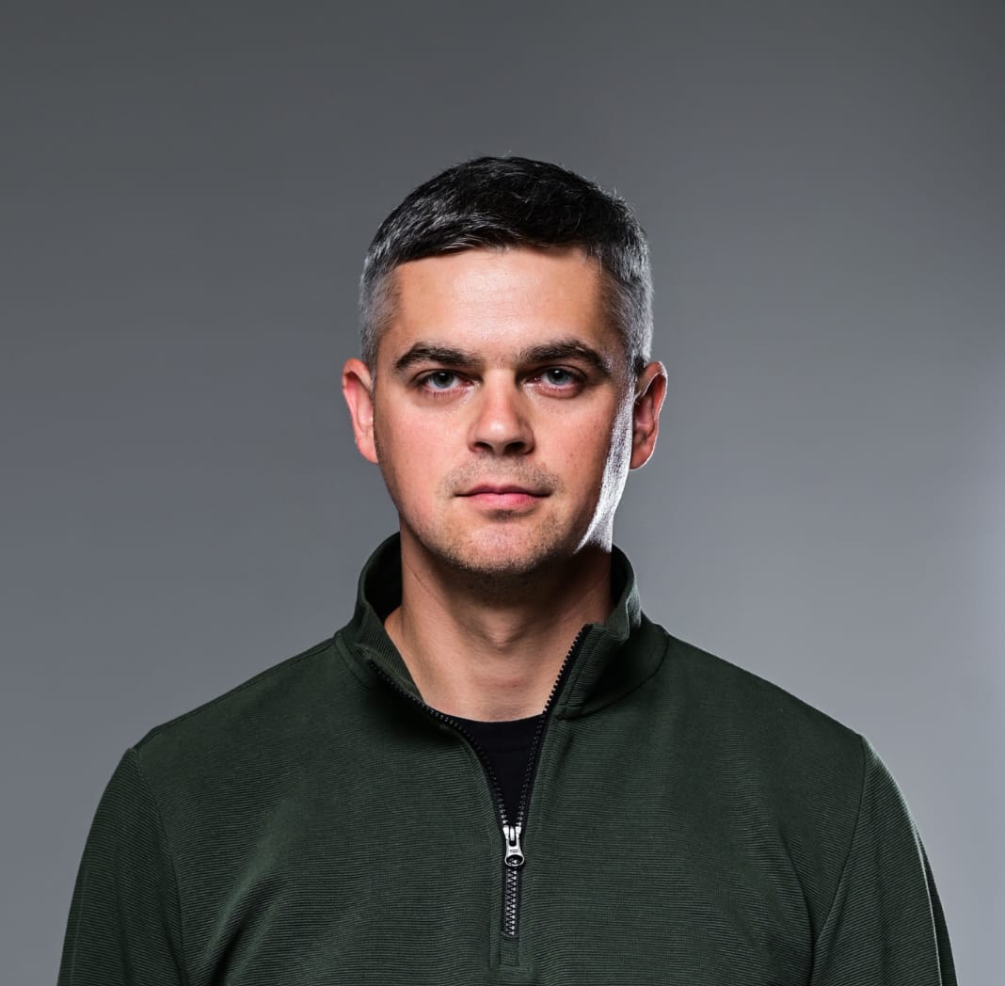



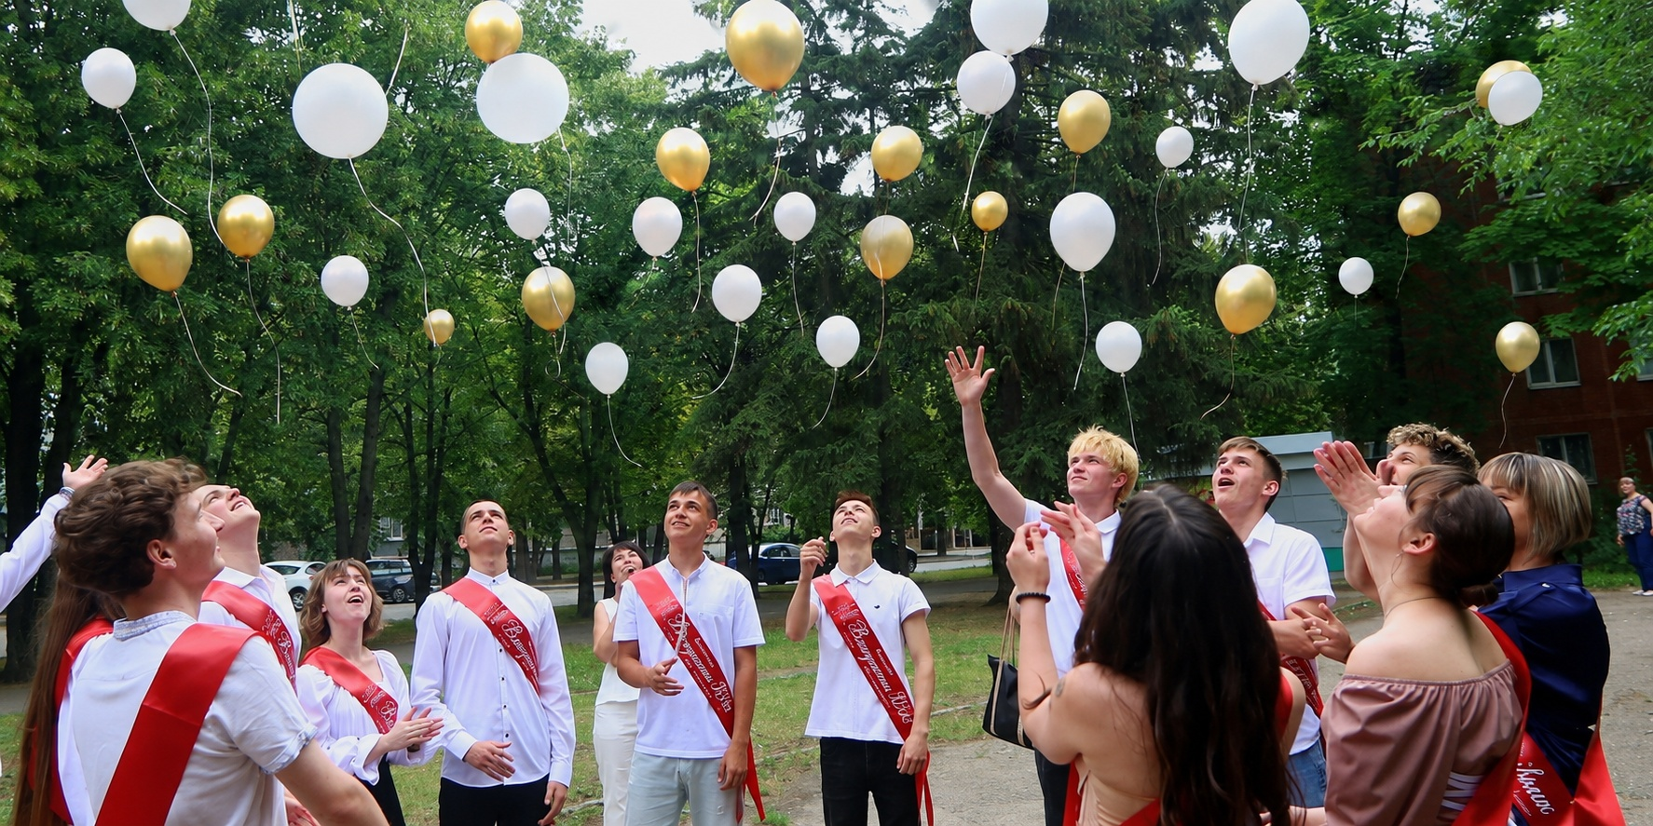
Thank You
Let’s build the next generation of community leaders together.
PROJECT LEAD & CONTACT
Vilkhuvatka Leadership & Learning Lab
Yevhen Shapoval
Community Leader
+380 50 575 14 48
A safe, modern space where displaced children and youth can learn, collaborate, develop digital skills, and prepare to rebuild their community.
vil_rada@ukr.net
Kharkivskykh Dyvizii St, 20, Kharkiv
Partnership opportunity: US$140,400
to launch the Lab
Together, we can turn a protected underground space into a long-term engine for youth leadership.
Vilkhuvatka Rural Military Administration • Kharkiv Region, Ukraine
The future starts with opportunity

